Slide 1
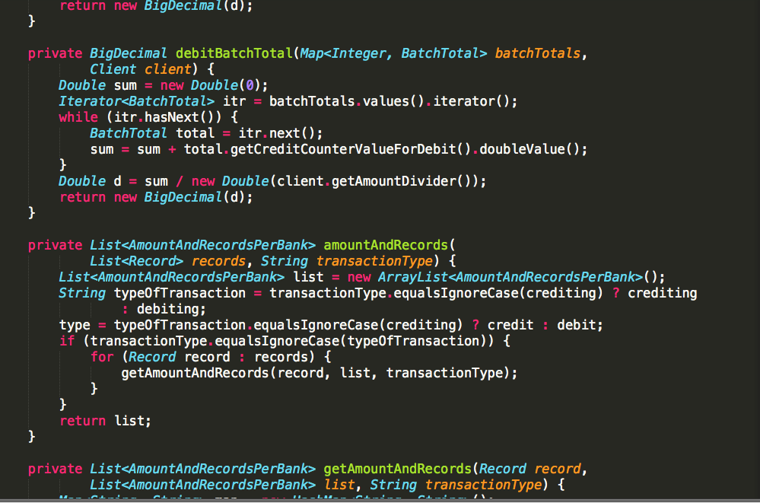

Slide 2
Short Enough
Notes:
C:\code\FluencyPowerPoint\PowerPointGeneration\PowerPointGeneration.Tests\CodeSmells-LongMethods\Short Enough 01.png

Slide 3
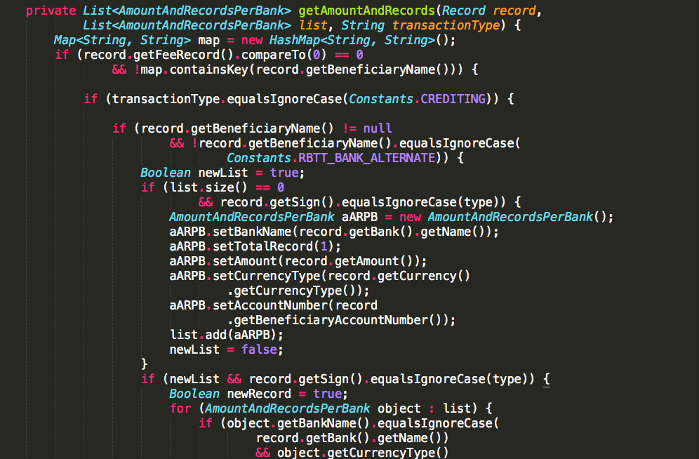

Slide 4
Too Long
Notes:
C:\code\FluencyPowerPoint\PowerPointGeneration\PowerPointGeneration.Tests\CodeSmells-LongMethods\Too Long 01.png

Slide 5
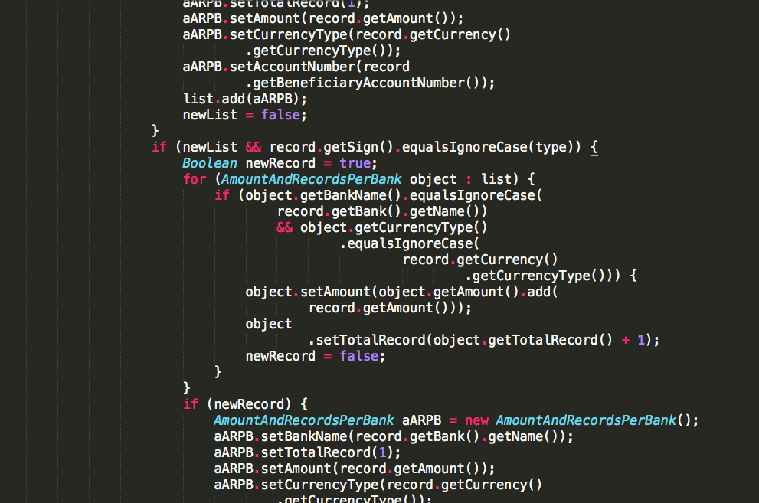

Slide 6
Too Long
Notes:
C:\code\FluencyPowerPoint\PowerPointGeneration\PowerPointGeneration.Tests\CodeSmells-LongMethods\Too Long 02.png

Slide 7
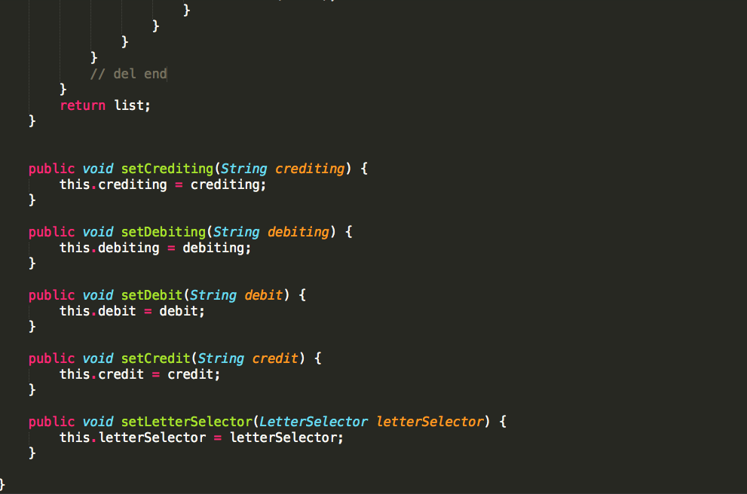

Slide 8
Short Enough
Notes:
C:\code\FluencyPowerPoint\PowerPointGeneration\PowerPointGeneration.Tests\CodeSmells-LongMethods\Short Enough 02.png

Slide 9
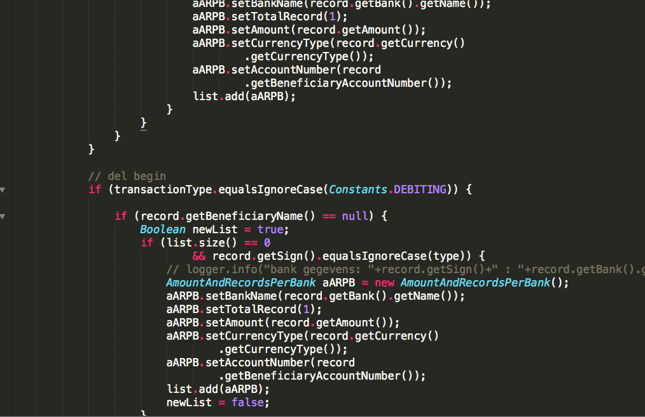

Slide 10
Too Long
Notes:
C:\code\FluencyPowerPoint\PowerPointGeneration\PowerPointGeneration.Tests\CodeSmells-LongMethods\Too Long 03.png

Slide 11
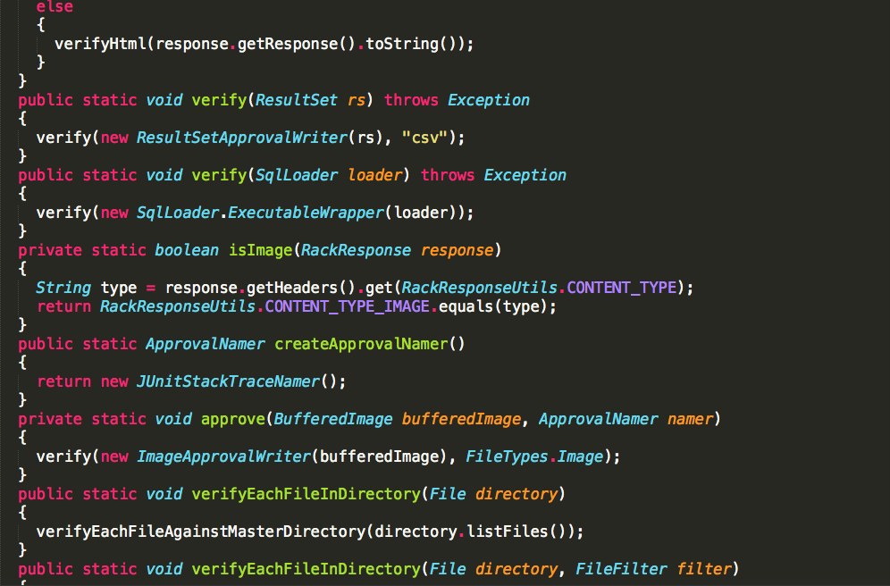

Slide 12
Short Enough
Notes:
C:\code\FluencyPowerPoint\PowerPointGeneration\PowerPointGeneration.Tests\CodeSmells-LongMethods\Short Enough 03.png

Slide 13
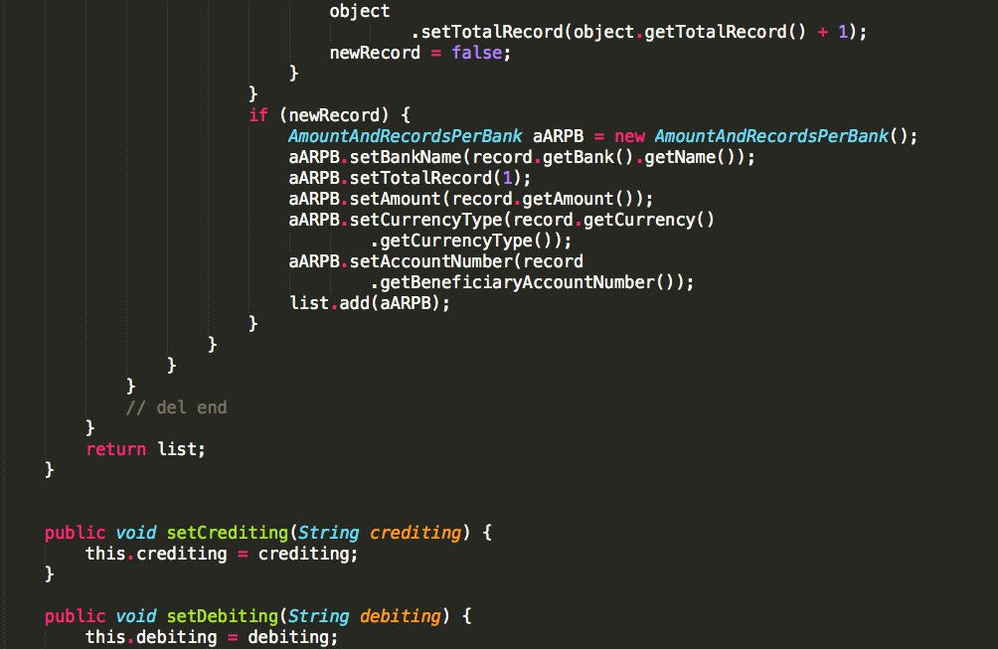

Slide 14
Too Long
Notes:
C:\code\FluencyPowerPoint\PowerPointGeneration\PowerPointGeneration.Tests\CodeSmells-LongMethods\Too Long 04.png

Slide 15
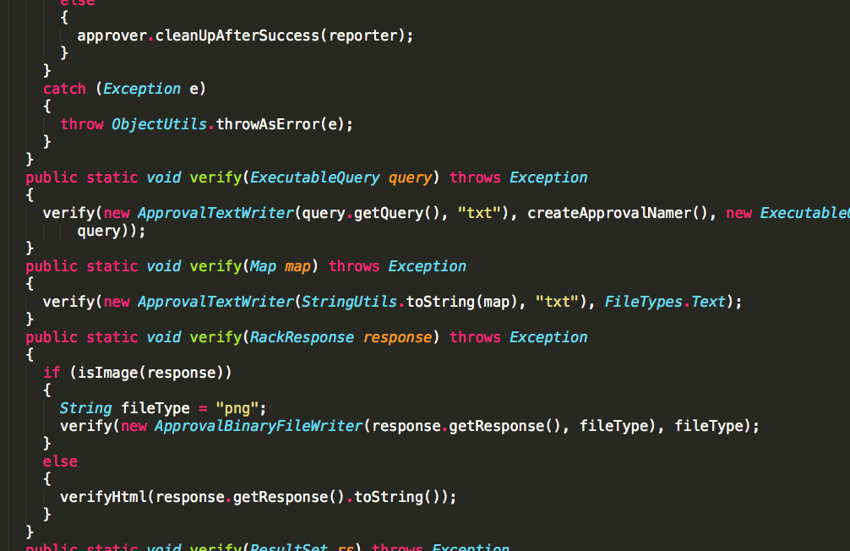

Slide 16
Short Enough
Notes:
C:\code\FluencyPowerPoint\PowerPointGeneration\PowerPointGeneration.Tests\CodeSmells-LongMethods\Short Enough 04.png

Slide 17
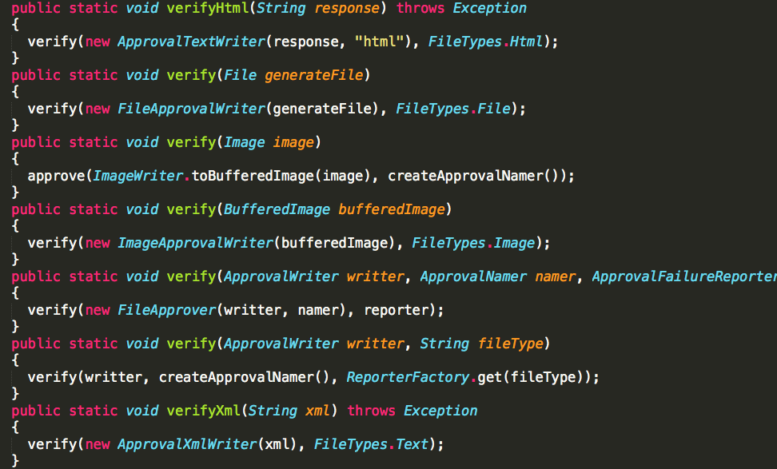

Slide 18
Short Enough
Notes:
C:\code\FluencyPowerPoint\PowerPointGeneration\PowerPointGeneration.Tests\CodeSmells-LongMethods\Short Enough 05.png

Slide 19
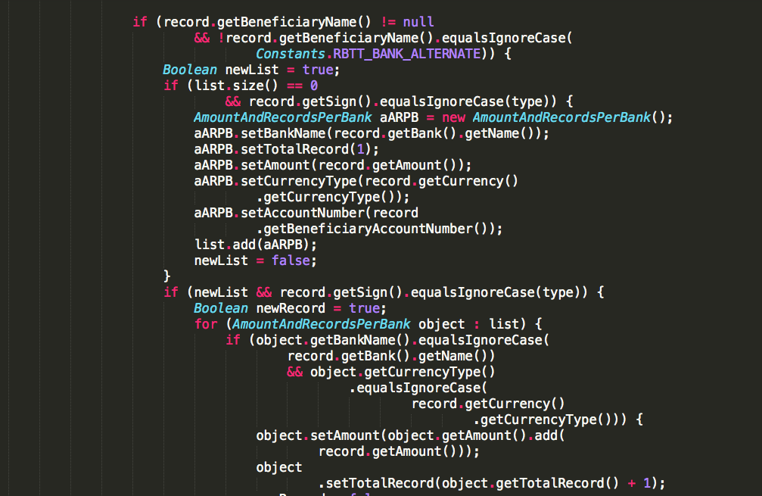

Slide 20
Too Long
Notes:
C:\code\FluencyPowerPoint\PowerPointGeneration\PowerPointGeneration.Tests\CodeSmells-LongMethods\Too Long 05.png

Slide 21
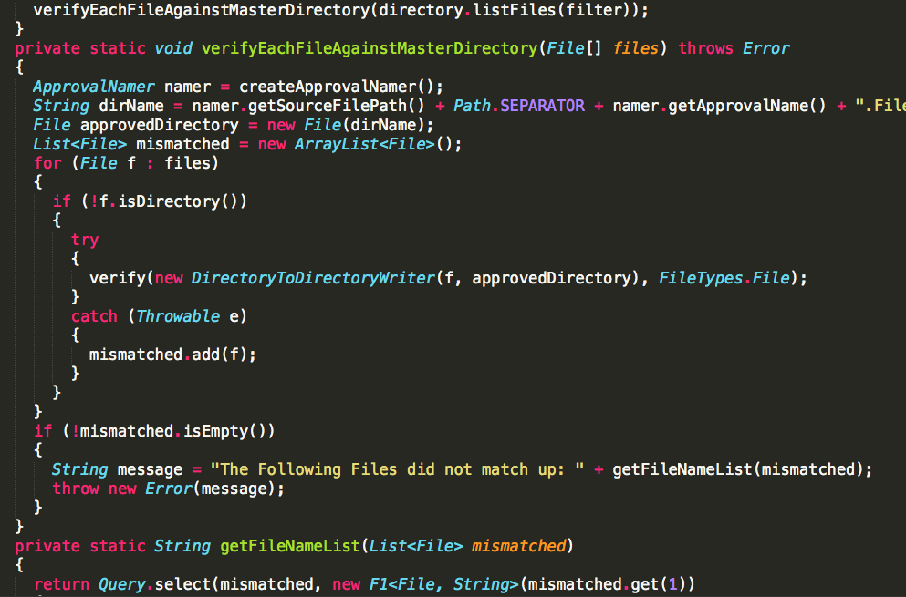

Slide 22
Short Enough
Notes:
C:\code\FluencyPowerPoint\PowerPointGeneration\PowerPointGeneration.Tests\CodeSmells-LongMethods\Short Enough 06.png

Slide 23
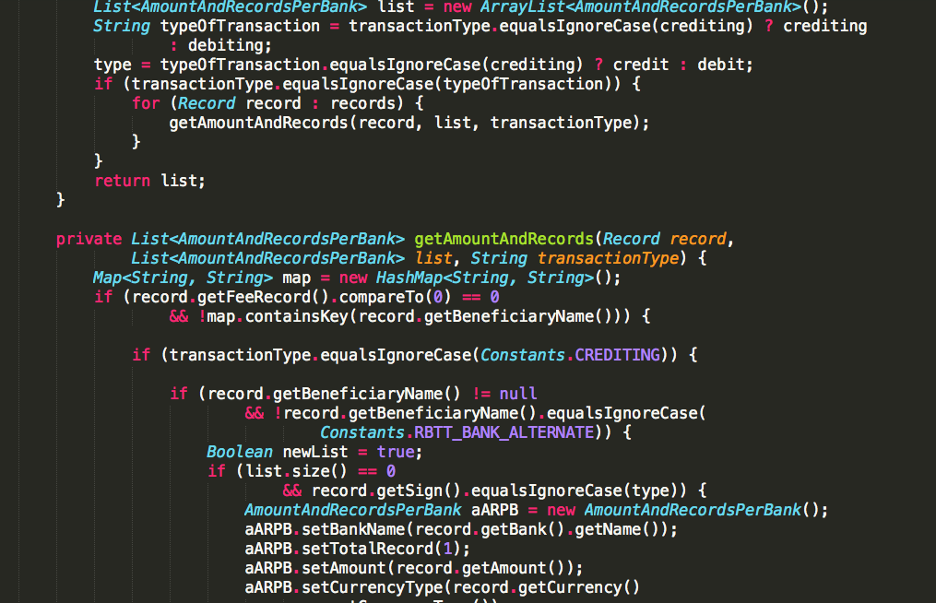

Slide 24
Too Long
Notes:
C:\code\FluencyPowerPoint\PowerPointGeneration\PowerPointGeneration.Tests\CodeSmells-LongMethods\Too Long 06.png

Slide 25
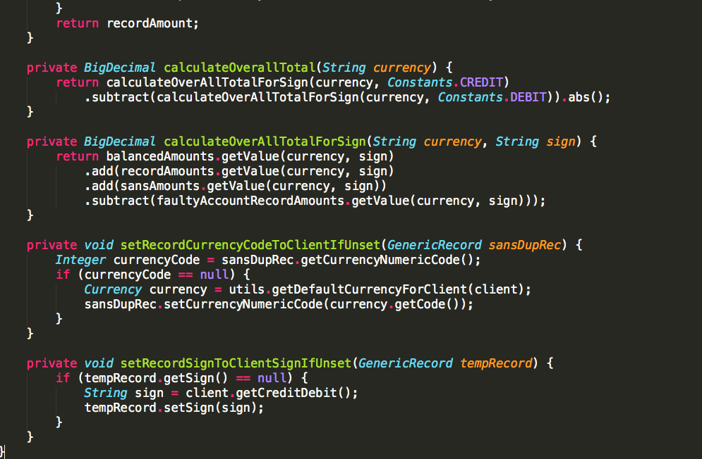

Slide 26
Short Enough
Notes:
C:\code\FluencyPowerPoint\PowerPointGeneration\PowerPointGeneration.Tests\CodeSmells-LongMethods\Short Enough 07.png

Slide 27
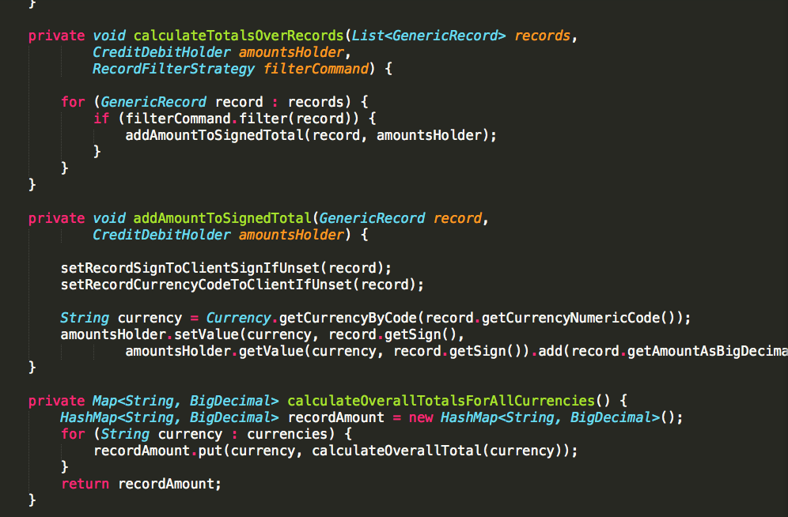

Slide 28
Short Enough
Notes:
C:\code\FluencyPowerPoint\PowerPointGeneration\PowerPointGeneration.Tests\CodeSmells-LongMethods\Short Enough 08.png

Slide 29
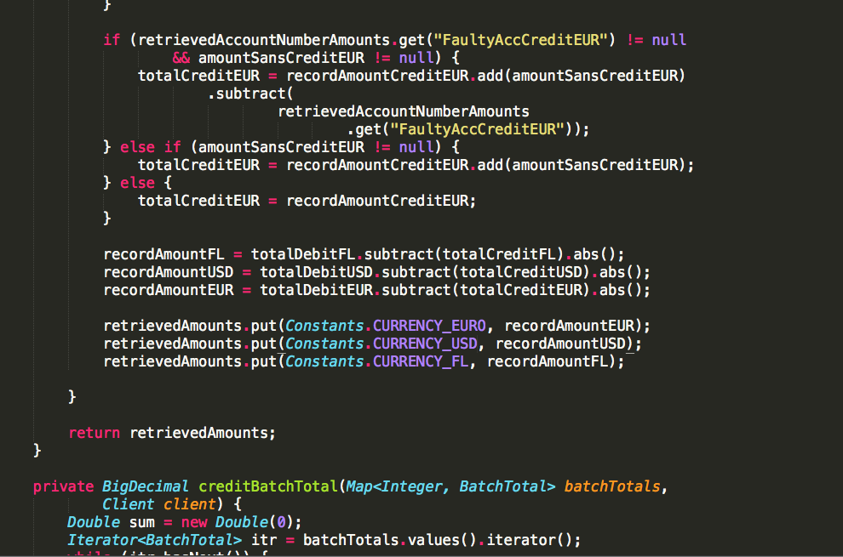

Slide 30
Too Long
Notes:
C:\code\FluencyPowerPoint\PowerPointGeneration\PowerPointGeneration.Tests\CodeSmells-LongMethods\Too Long 07.png

Slide 31
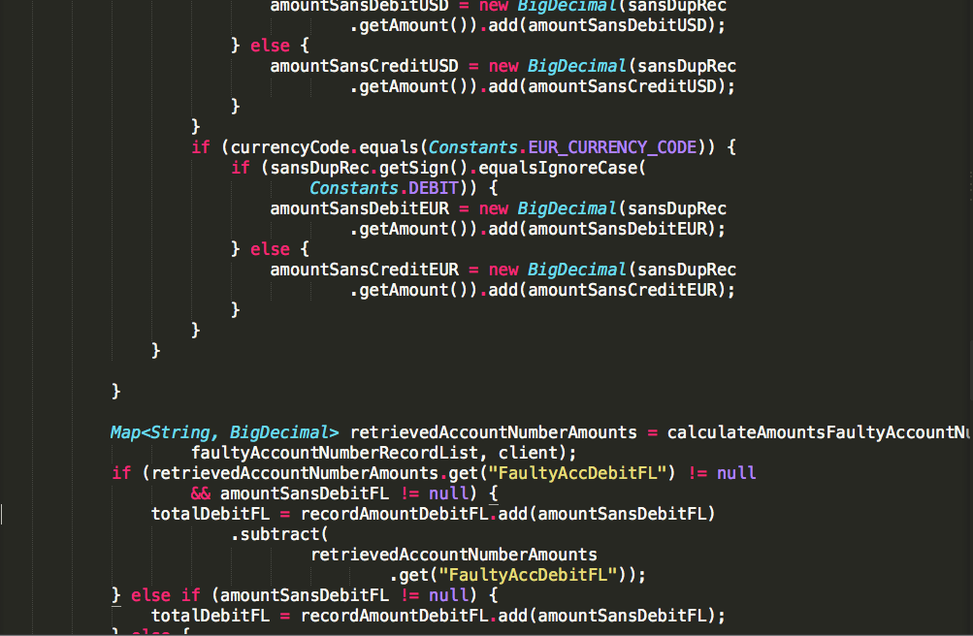

Slide 32
Too Long
Notes:
C:\code\FluencyPowerPoint\PowerPointGeneration\PowerPointGeneration.Tests\CodeSmells-LongMethods\Too Long 08.png

Slide 33
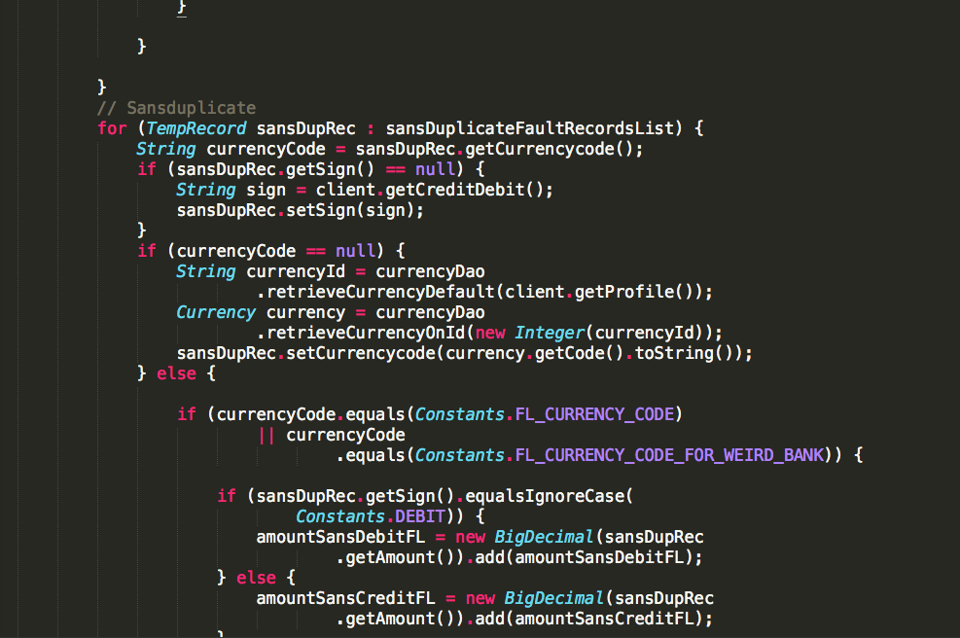

Slide 34
Too Long
Notes:
C:\code\FluencyPowerPoint\PowerPointGeneration\PowerPointGeneration.Tests\CodeSmells-LongMethods\Too Long 09.png

Slide 35
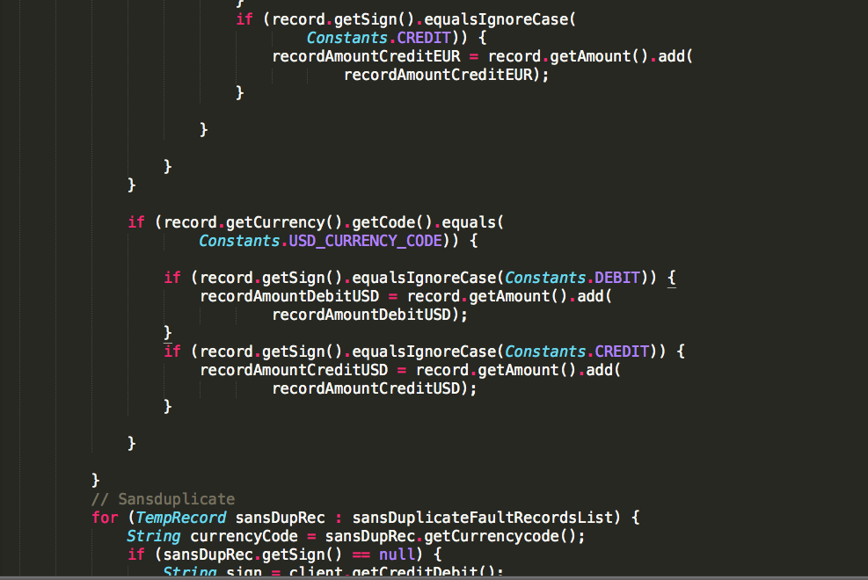

Slide 36
Too Long
Notes:
C:\code\FluencyPowerPoint\PowerPointGeneration\PowerPointGeneration.Tests\CodeSmells-LongMethods\Too Long 10.png

Slide 37
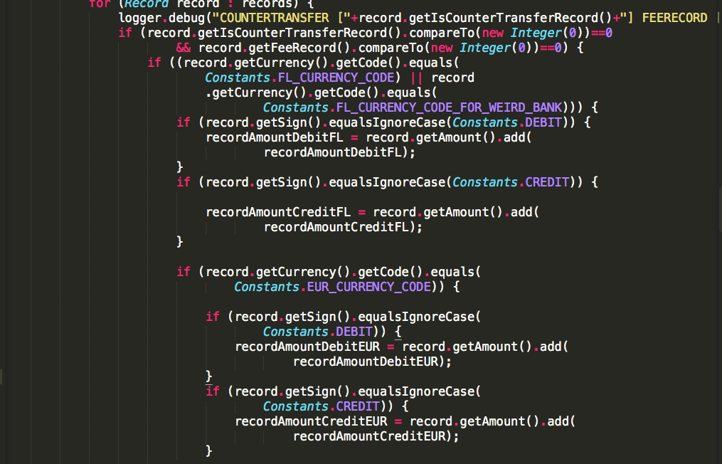

Slide 38
Too Long
Notes:
C:\code\FluencyPowerPoint\PowerPointGeneration\PowerPointGeneration.Tests\CodeSmells-LongMethods\Too Long 11.png

Slide 39
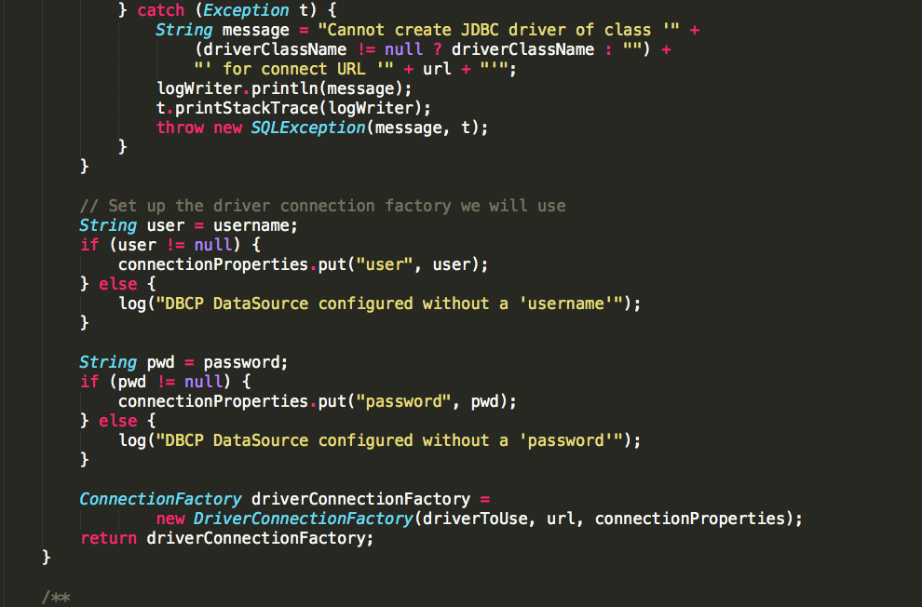

Slide 40
Too Long
Notes:
C:\code\FluencyPowerPoint\PowerPointGeneration\PowerPointGeneration.Tests\CodeSmells-LongMethods\Too Long 12.png

Slide 41
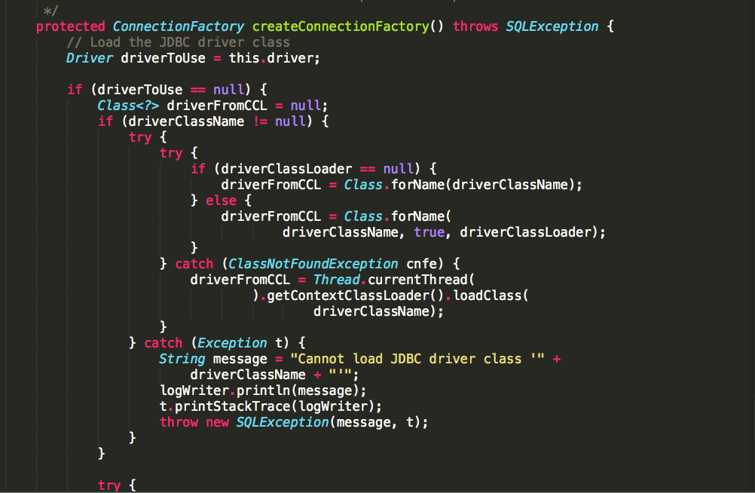

Slide 42
Too Long
Notes:
C:\code\FluencyPowerPoint\PowerPointGeneration\PowerPointGeneration.Tests\CodeSmells-LongMethods\Too Long 13.png

Slide 43
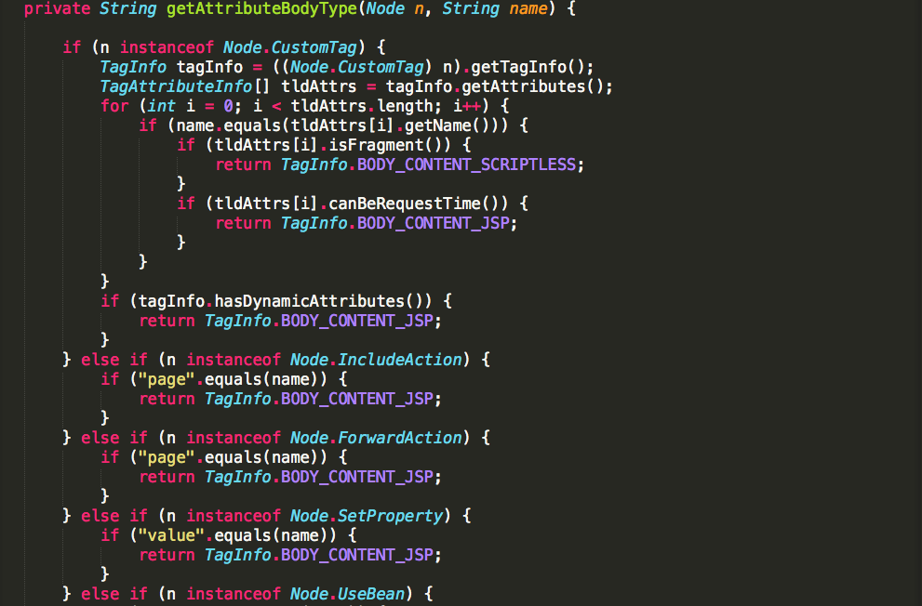

Slide 44
Too Long
Notes:
C:\code\FluencyPowerPoint\PowerPointGeneration\PowerPointGeneration.Tests\CodeSmells-LongMethods\Too Long 14.png

Slide 45
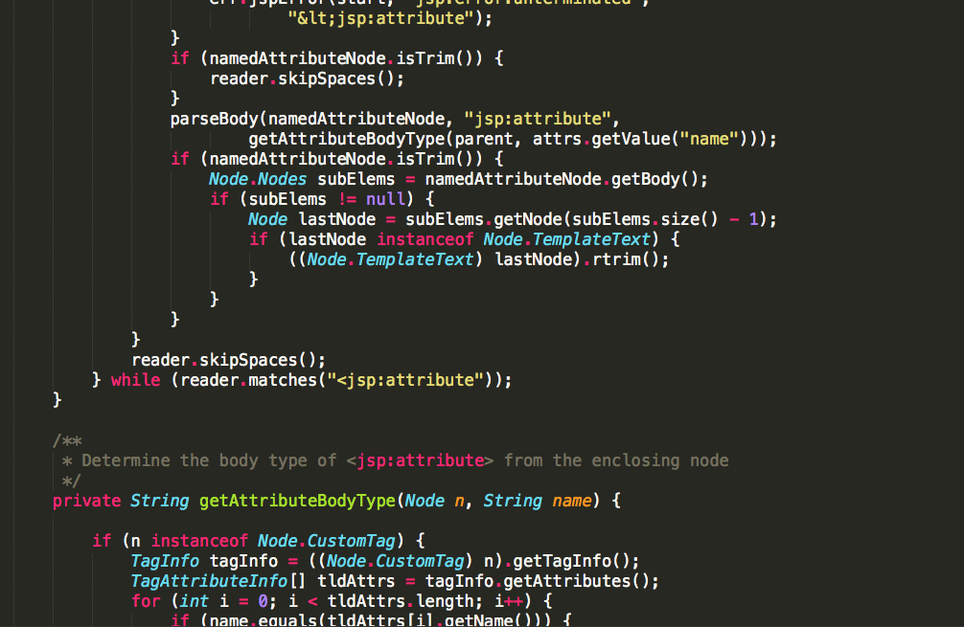

Slide 46
Too Long
Notes:
C:\code\FluencyPowerPoint\PowerPointGeneration\PowerPointGeneration.Tests\CodeSmells-LongMethods\Too Long 15.png

Slide 47
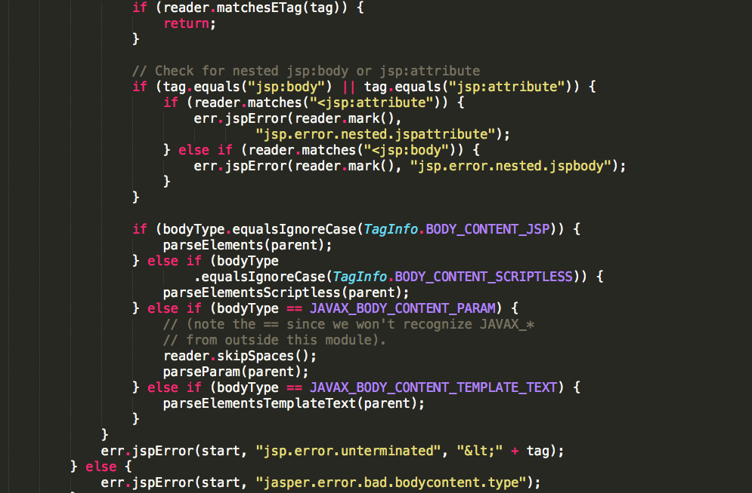

Slide 48
Too Long
Notes:
C:\code\FluencyPowerPoint\PowerPointGeneration\PowerPointGeneration.Tests\CodeSmells-LongMethods\Too Long 16.png

Slide 49
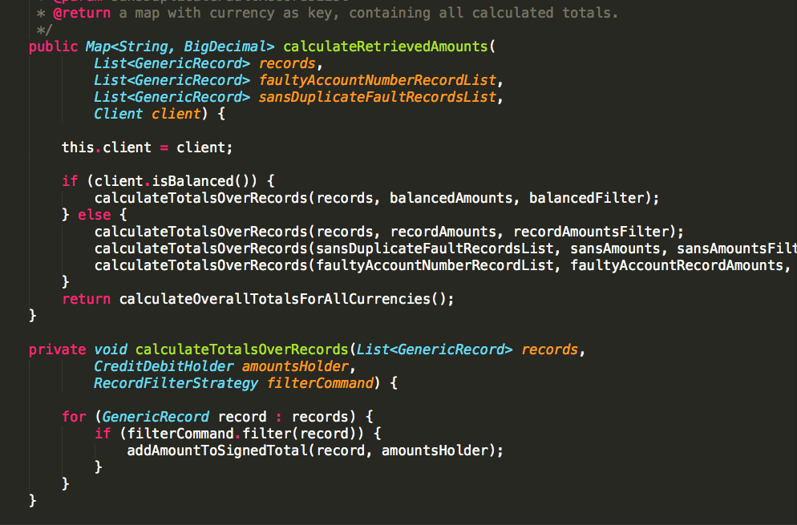

Slide 50
Short Enough
Notes:
C:\code\FluencyPowerPoint\PowerPointGeneration\PowerPointGeneration.Tests\CodeSmells-LongMethods\Short Enough 09.png

Slide 51
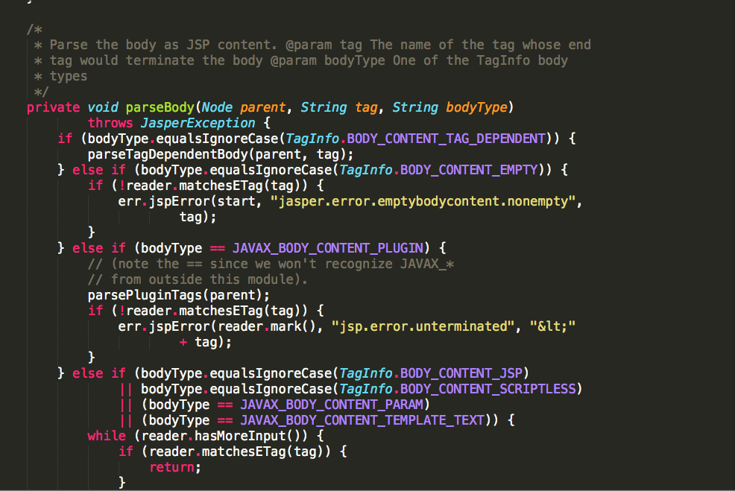

Slide 52
Too Long
Notes:
C:\code\FluencyPowerPoint\PowerPointGeneration\PowerPointGeneration.Tests\CodeSmells-LongMethods\Too Long 17.png

Slide 53
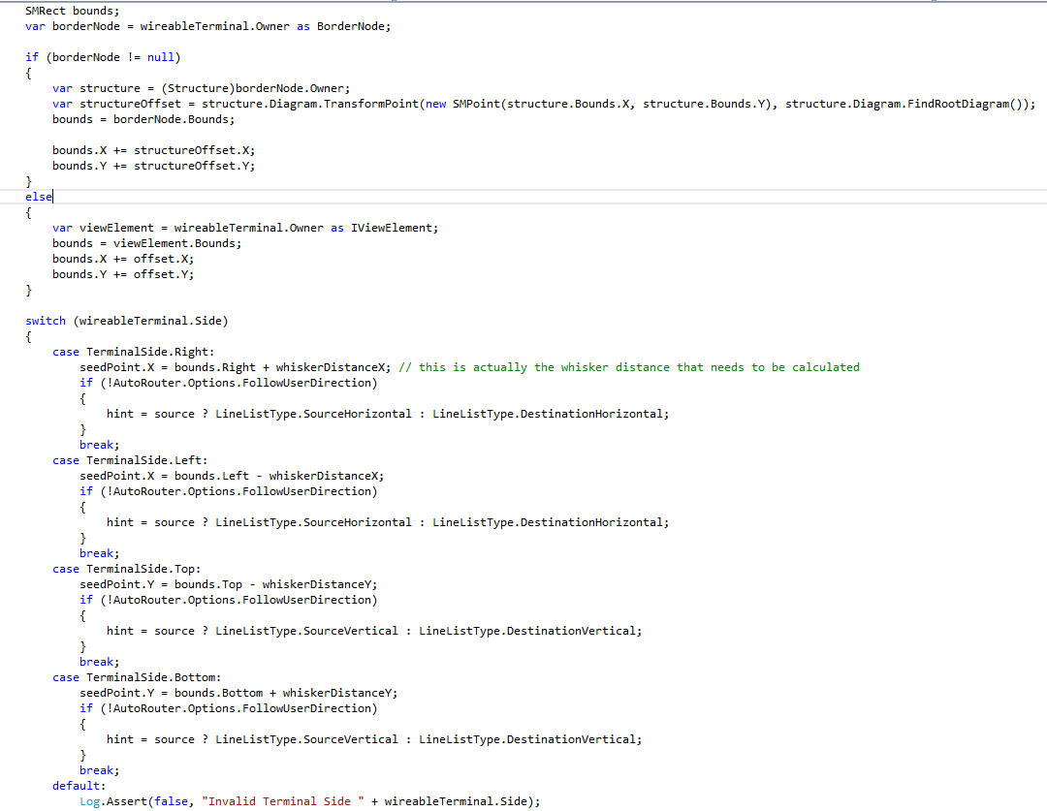

Slide 54
Too Long
Notes:
C:\code\FluencyPowerPoint\PowerPointGeneration\PowerPointGeneration.Tests\CodeSmells-LongMethods\Too Long 18.png

Slide 55
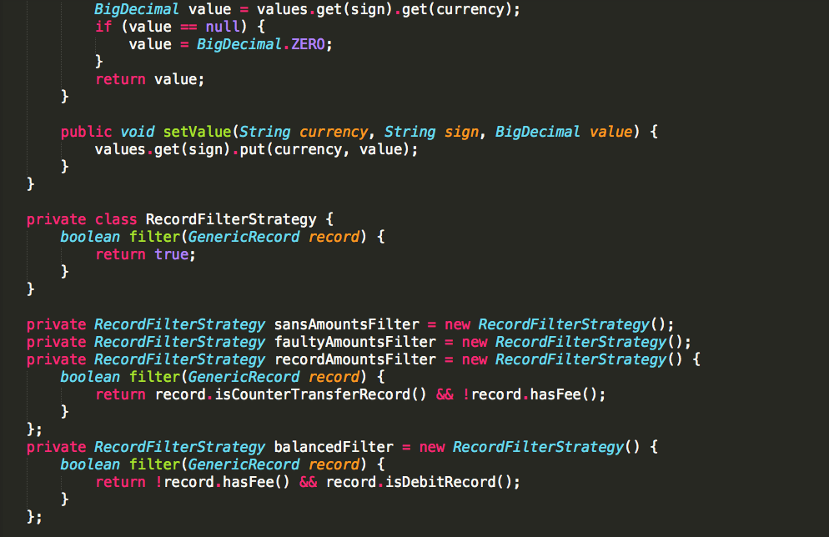

Slide 56
Short Enough
Notes:
C:\code\FluencyPowerPoint\PowerPointGeneration\PowerPointGeneration.Tests\CodeSmells-LongMethods\Short Enough 10.png

Slide 57
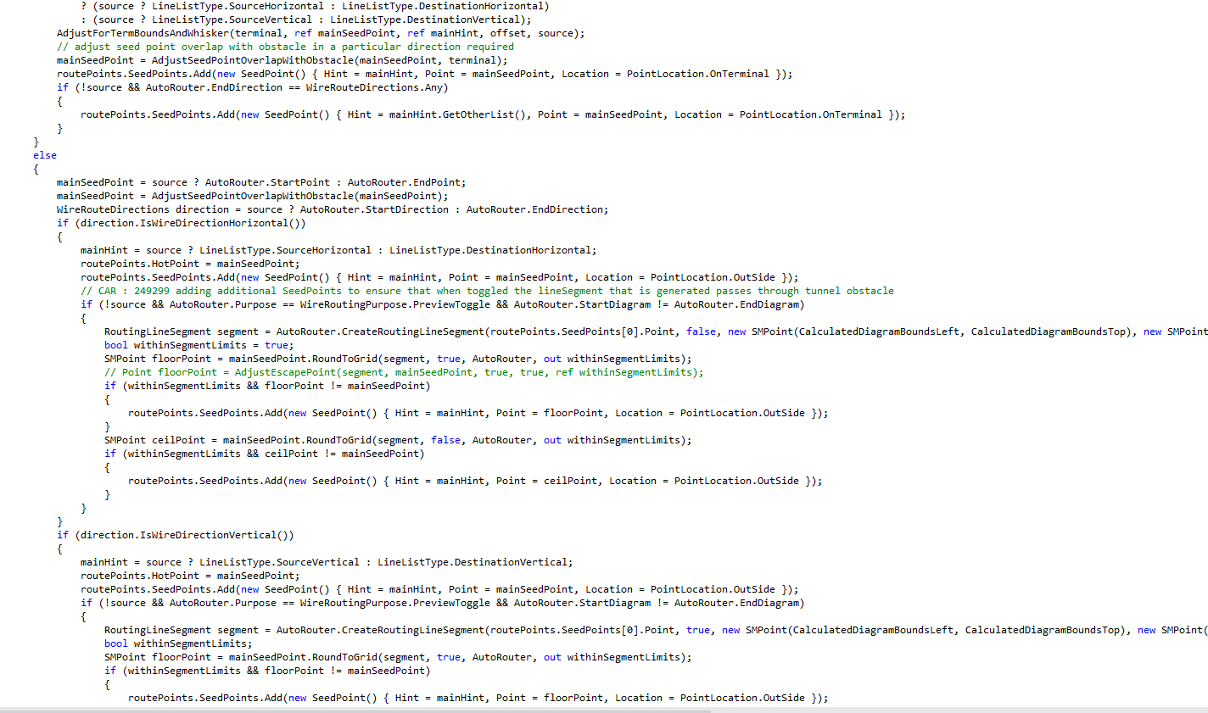

Slide 58
Too Long
Notes:
C:\code\FluencyPowerPoint\PowerPointGeneration\PowerPointGeneration.Tests\CodeSmells-LongMethods\Too Long 19.png

Slide 59
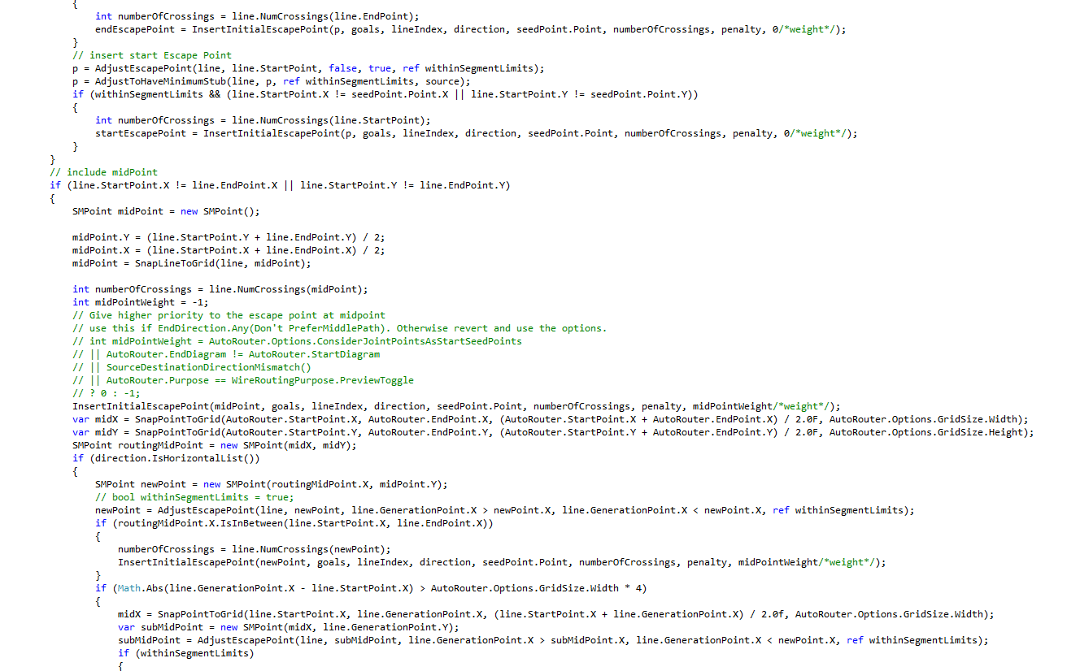

Slide 60
Too Long
Notes:
C:\code\FluencyPowerPoint\PowerPointGeneration\PowerPointGeneration.Tests\CodeSmells-LongMethods\Too Long 20.png

Slide 61
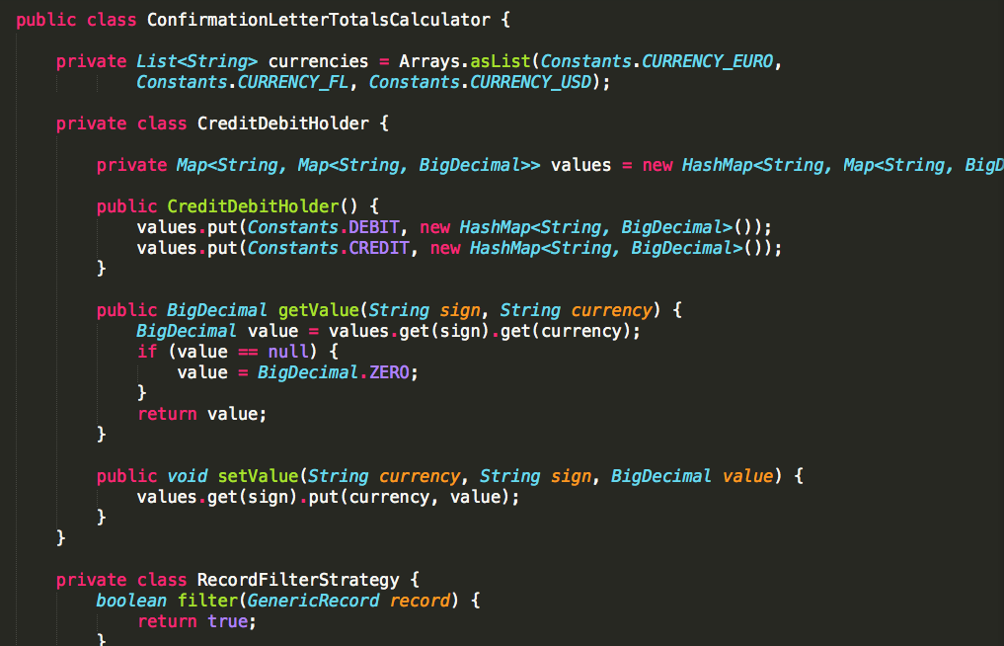

Slide 62
Short Enough
Notes:
C:\code\FluencyPowerPoint\PowerPointGeneration\PowerPointGeneration.Tests\CodeSmells-LongMethods\Short Enough 11.png

Slide 63
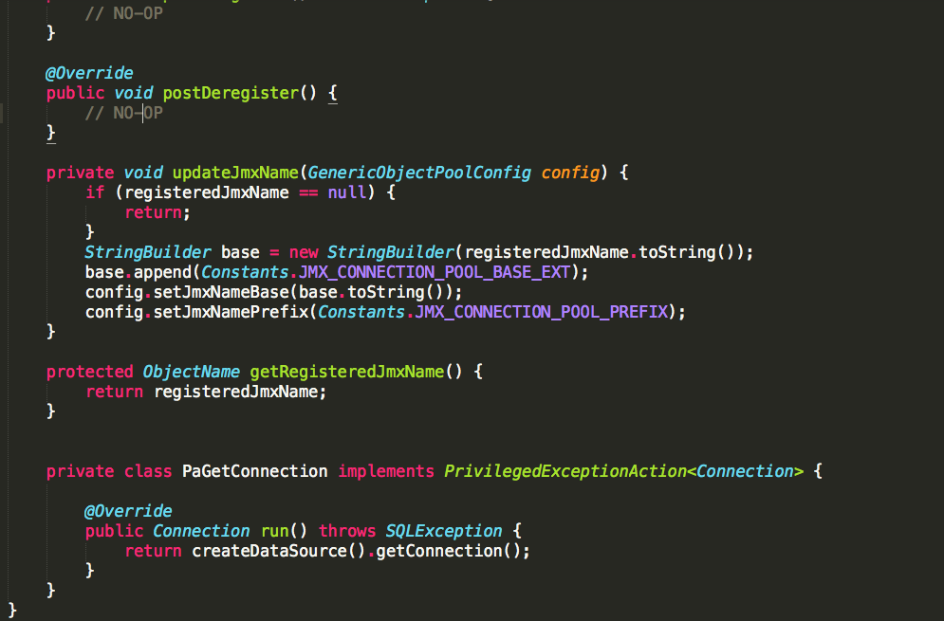

Slide 64
Short Enough
Notes:
C:\code\FluencyPowerPoint\PowerPointGeneration\PowerPointGeneration.Tests\CodeSmells-LongMethods\Short Enough 12.png

Slide 65
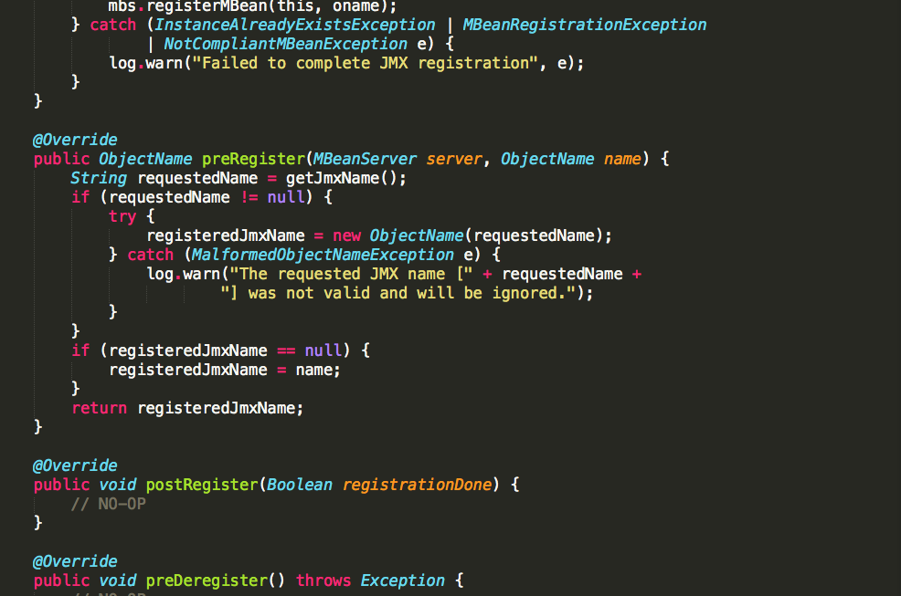

Slide 66
Short Enough
Notes:
C:\code\FluencyPowerPoint\PowerPointGeneration\PowerPointGeneration.Tests\CodeSmells-LongMethods\Short Enough 13.png

Slide 67
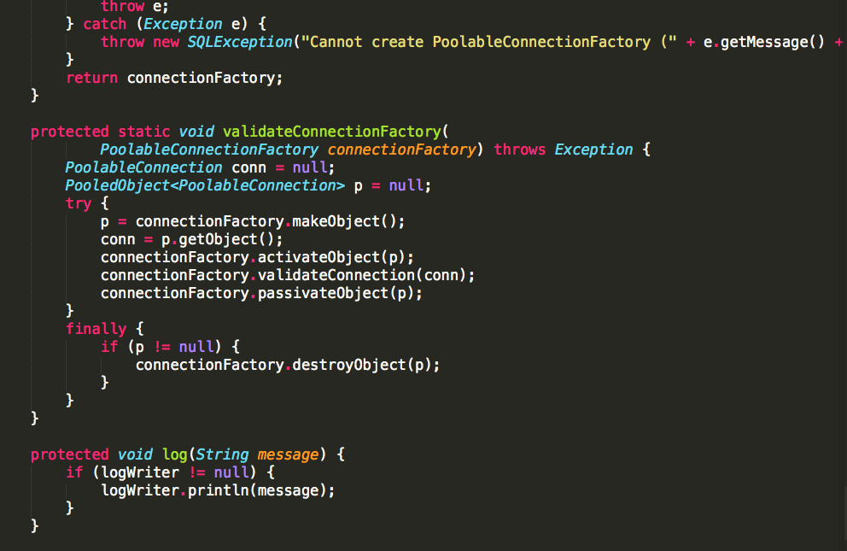

Slide 68
Short Enough
Notes:
C:\code\FluencyPowerPoint\PowerPointGeneration\PowerPointGeneration.Tests\CodeSmells-LongMethods\Short Enough 14.png

Slide 69
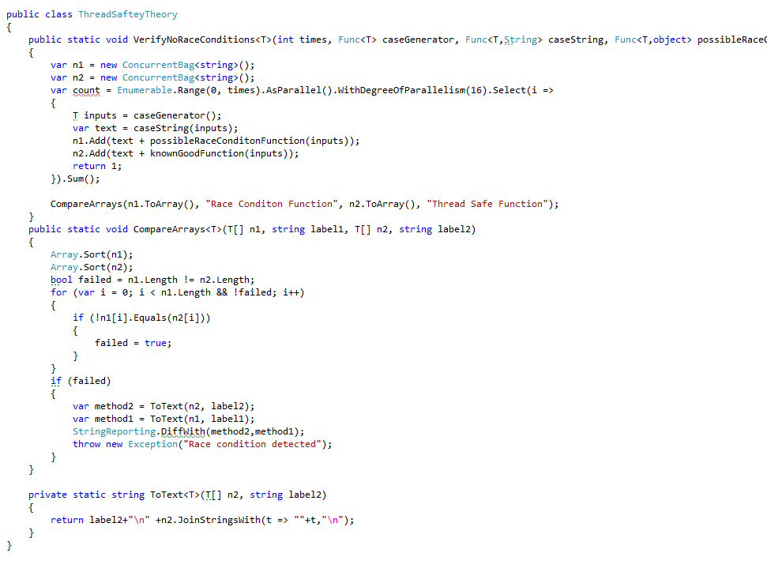

Slide 70
Short Enough
Notes:
C:\code\FluencyPowerPoint\PowerPointGeneration\PowerPointGeneration.Tests\CodeSmells-LongMethods\Short Enough 15.png

Slide 71
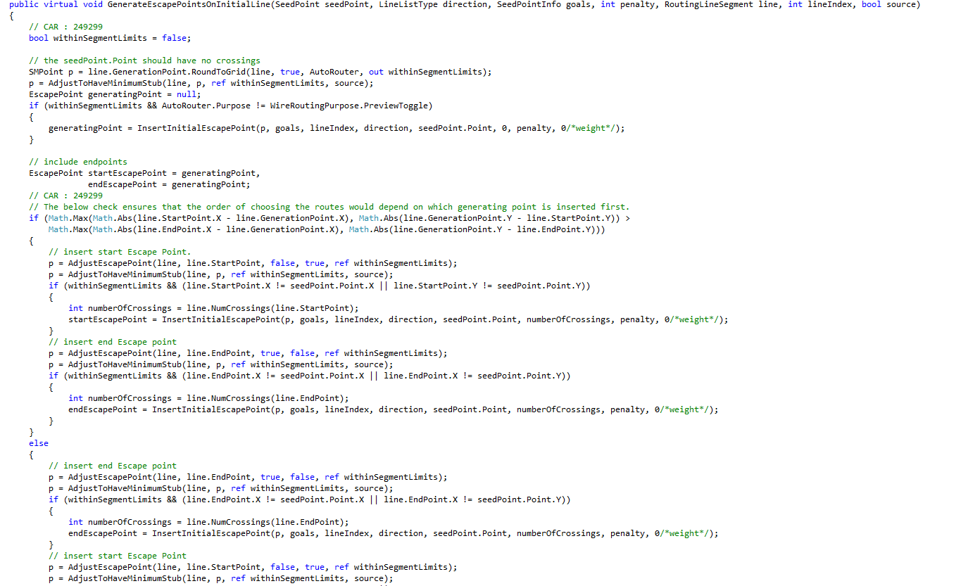

Slide 72
Too Long
Notes:
C:\code\FluencyPowerPoint\PowerPointGeneration\PowerPointGeneration.Tests\CodeSmells-LongMethods\Too Long 21.png

Slide 73
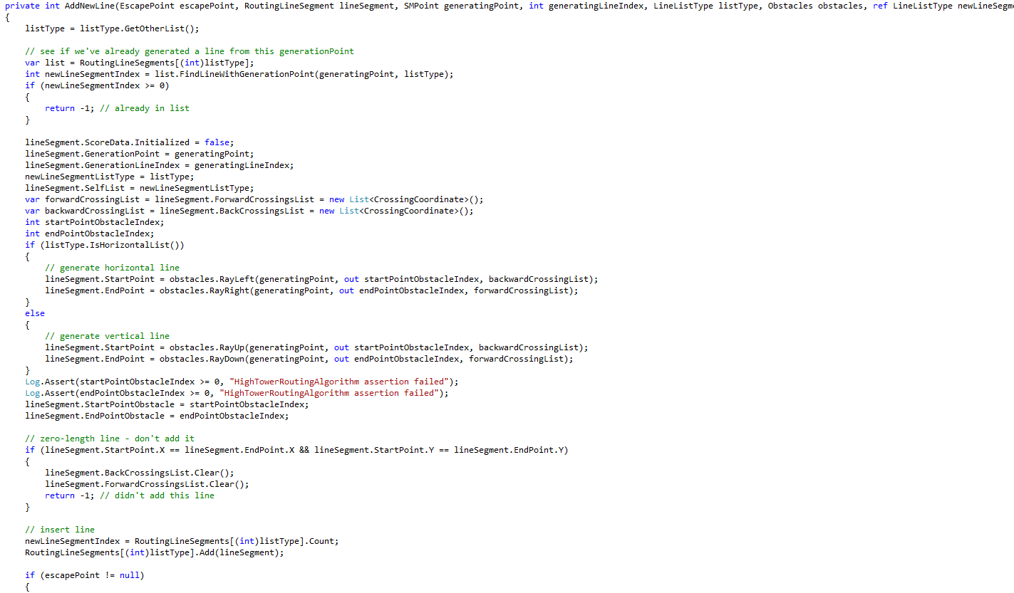

Slide 74
Too Long
Notes:
C:\code\FluencyPowerPoint\PowerPointGeneration\PowerPointGeneration.Tests\CodeSmells-LongMethods\Too Long 22.png

Slide 75
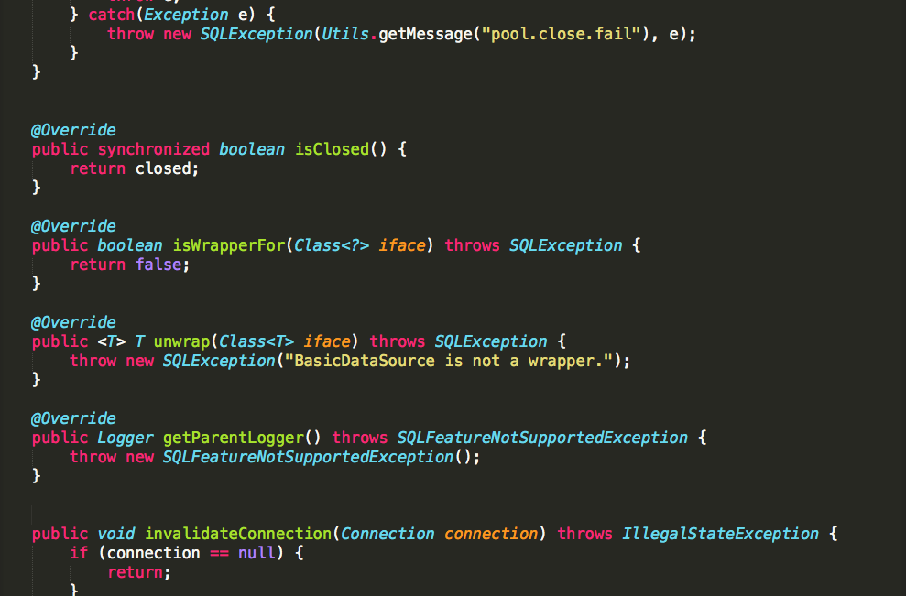

Slide 76
Short Enough
Notes:
C:\code\FluencyPowerPoint\PowerPointGeneration\PowerPointGeneration.Tests\CodeSmells-LongMethods\Short Enough 16.png

Slide 77
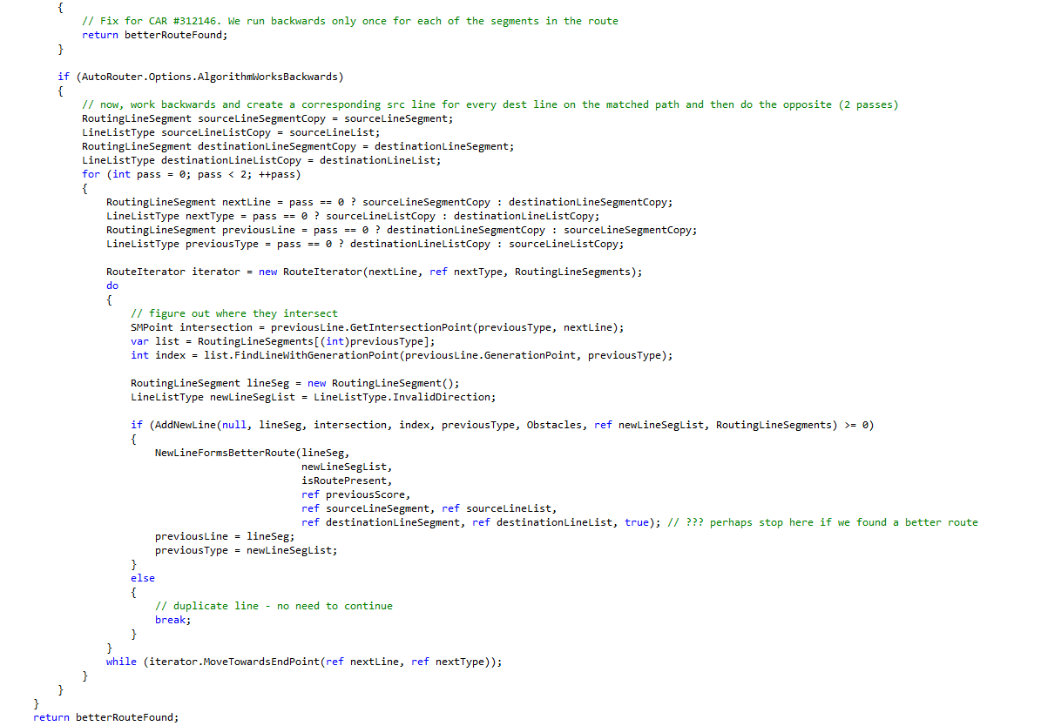

Slide 78
Too Long
Notes:
C:\code\FluencyPowerPoint\PowerPointGeneration\PowerPointGeneration.Tests\CodeSmells-LongMethods\Too Long 23.png

Slide 79
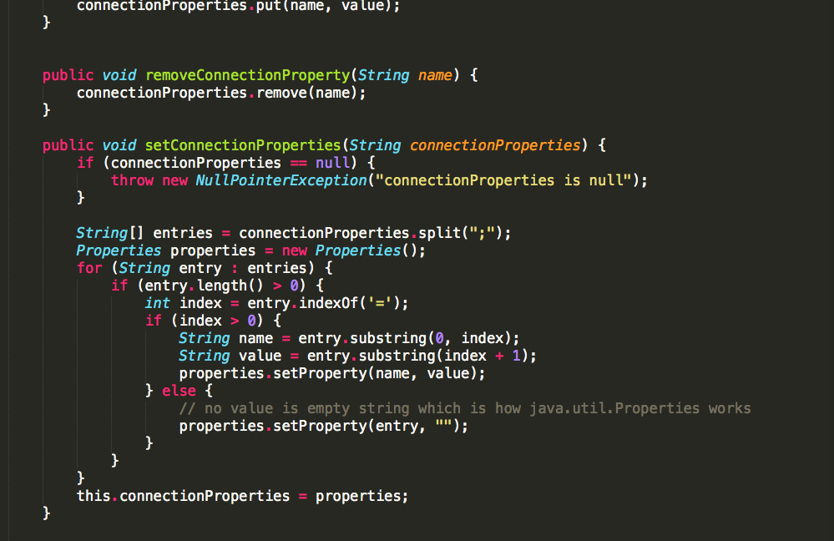

Slide 80
Short Enough
Notes:
C:\code\FluencyPowerPoint\PowerPointGeneration\PowerPointGeneration.Tests\CodeSmells-LongMethods\Short Enough 17.png

Slide 81
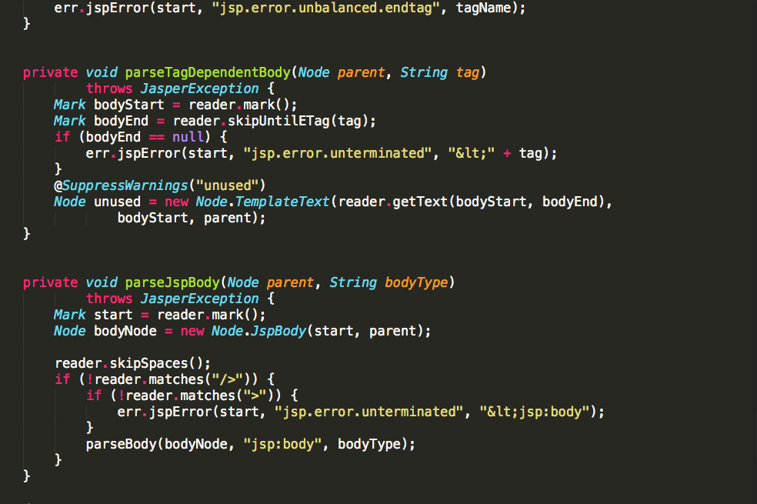

Slide 82
Short Enough
Notes:
C:\code\FluencyPowerPoint\PowerPointGeneration\PowerPointGeneration.Tests\CodeSmells-LongMethods\Short Enough 18.png

Slide 83
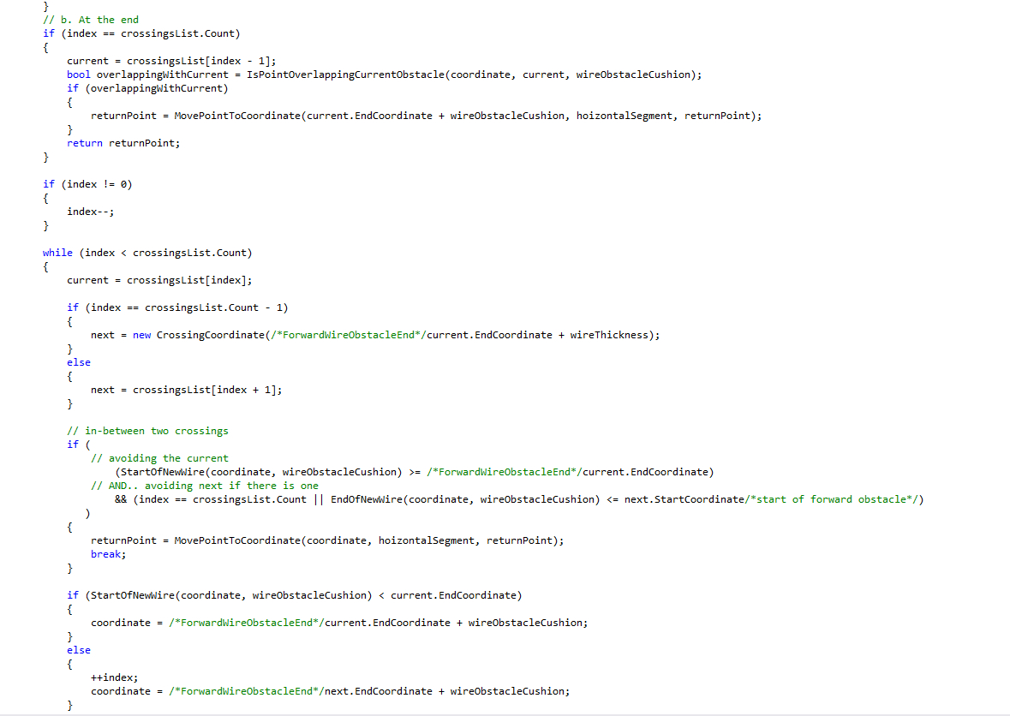

Slide 84
Too Long
Notes:
C:\code\FluencyPowerPoint\PowerPointGeneration\PowerPointGeneration.Tests\CodeSmells-LongMethods\Too Long 24.png

Slide 85
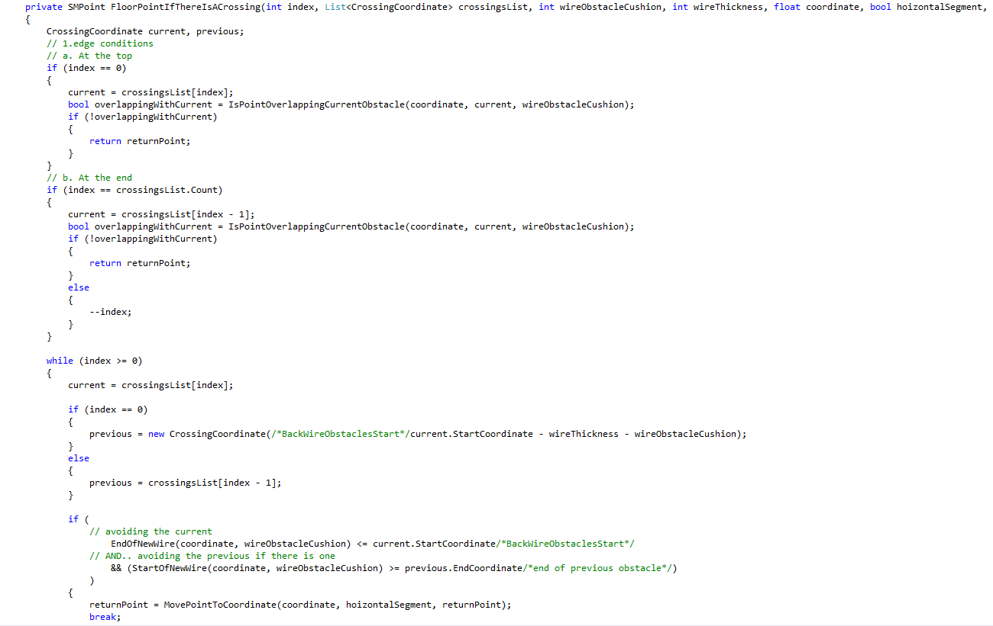

Slide 86
Too Long
Notes:
C:\code\FluencyPowerPoint\PowerPointGeneration\PowerPointGeneration.Tests\CodeSmells-LongMethods\Too Long 25.png

Slide 87
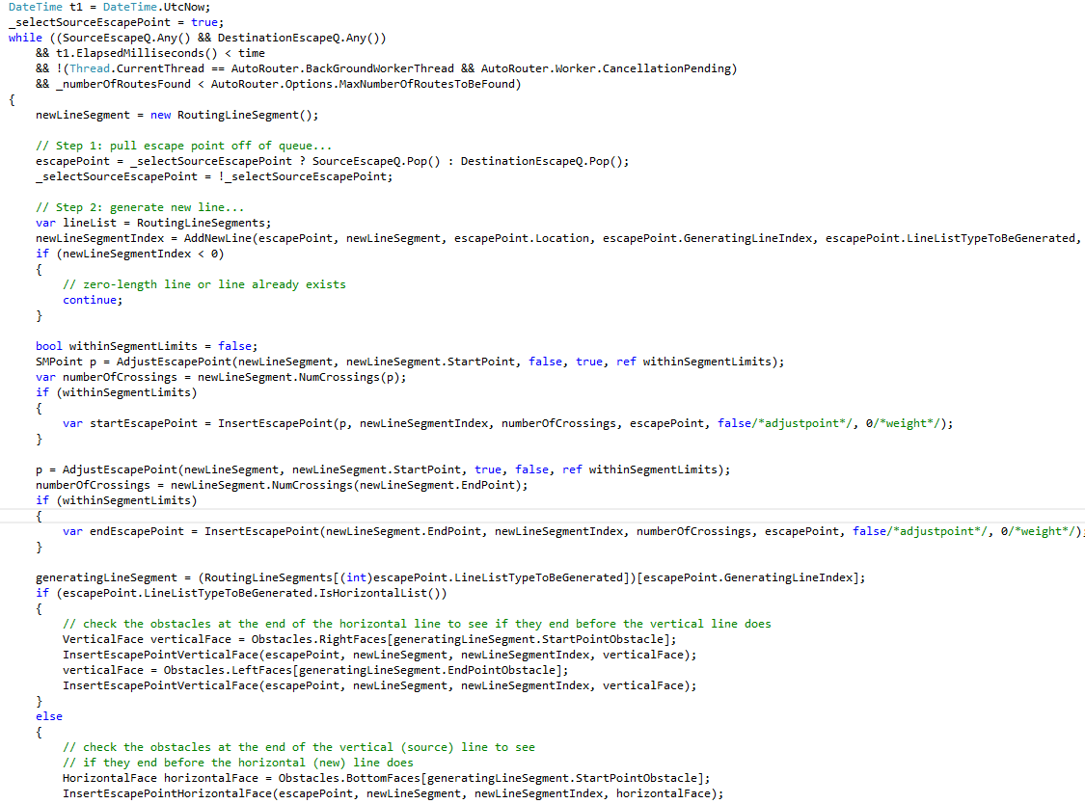

Slide 88
Too Long
Notes:
C:\code\FluencyPowerPoint\PowerPointGeneration\PowerPointGeneration.Tests\CodeSmells-LongMethods\Too Long 26.png

Slide 89
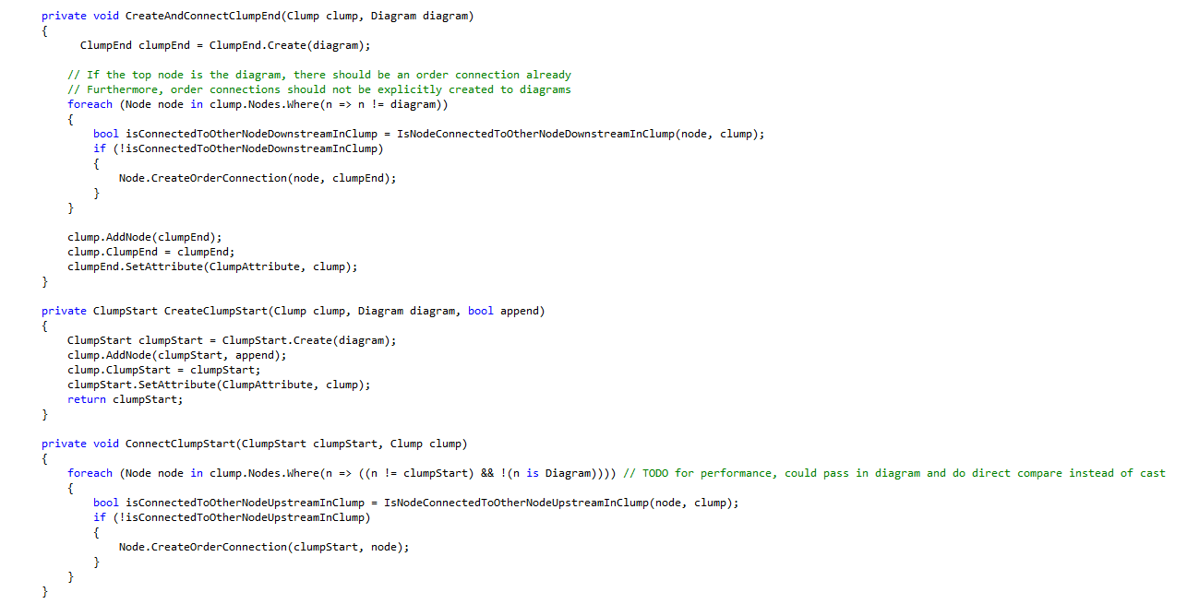

Slide 90
Short Enough
Notes:
C:\code\FluencyPowerPoint\PowerPointGeneration\PowerPointGeneration.Tests\CodeSmells-LongMethods\Short Enough 19.png

Slide 91
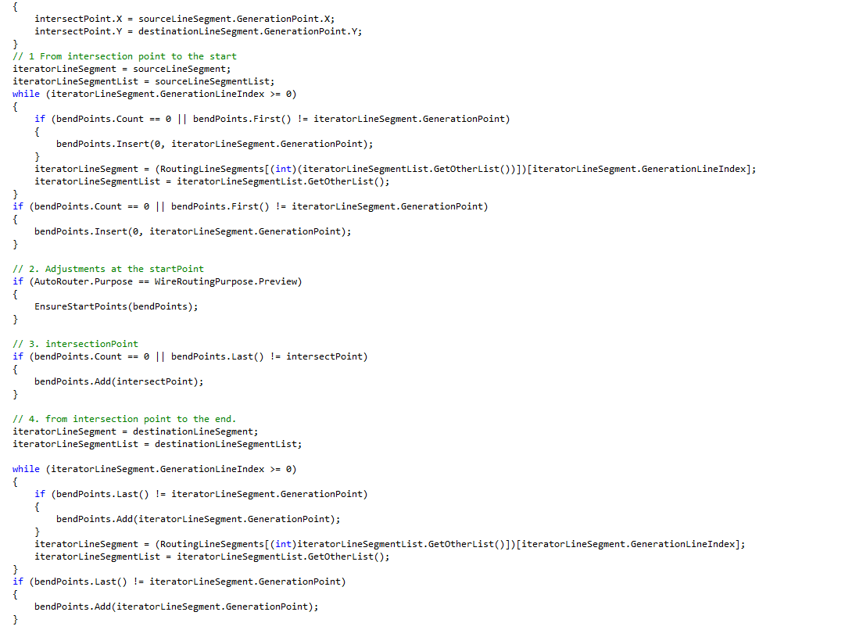

Slide 92
Too Long
Notes:
C:\code\FluencyPowerPoint\PowerPointGeneration\PowerPointGeneration.Tests\CodeSmells-LongMethods\Too Long 27.png

Slide 93
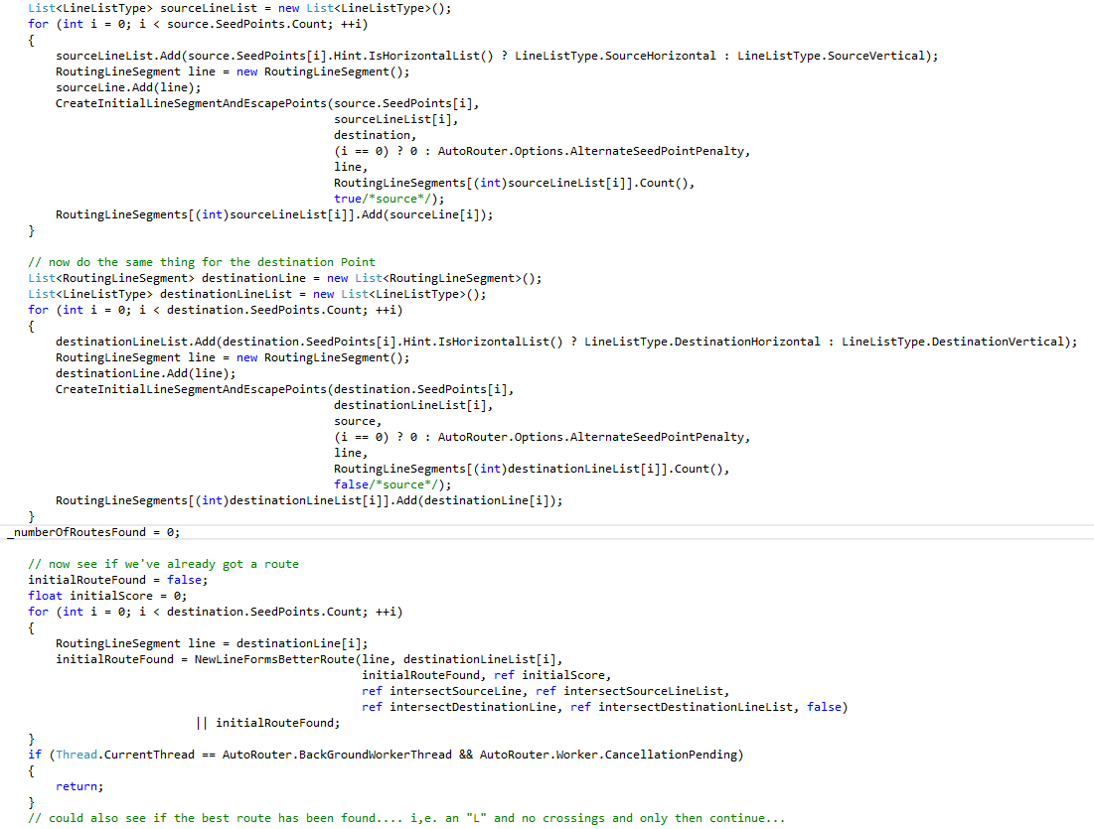

Slide 94
Too Long
Notes:
C:\code\FluencyPowerPoint\PowerPointGeneration\PowerPointGeneration.Tests\CodeSmells-LongMethods\Too Long 28.png

Slide 95
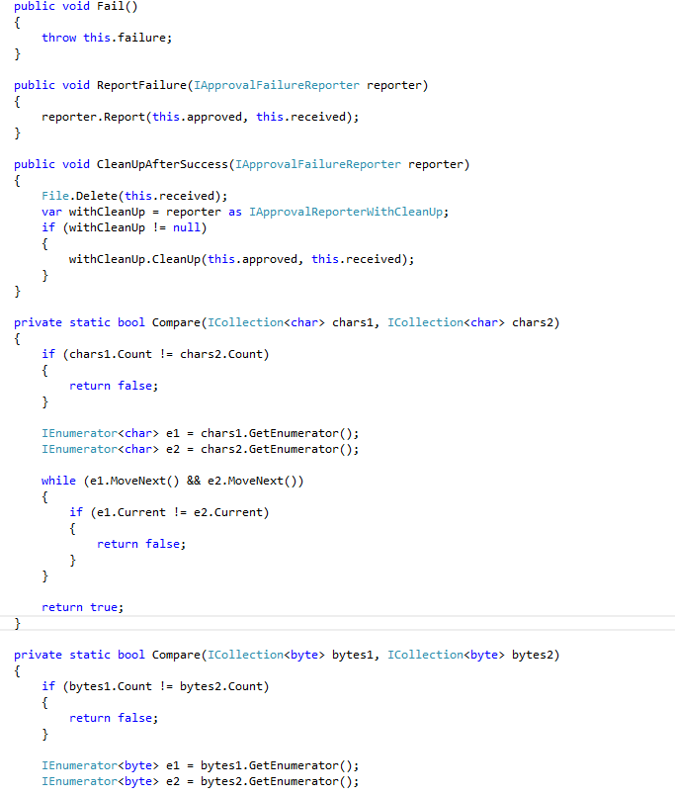

Slide 96
Short Enough
Notes:
C:\code\FluencyPowerPoint\PowerPointGeneration\PowerPointGeneration.Tests\CodeSmells-LongMethods\Short Enough 20.png

Slide 97
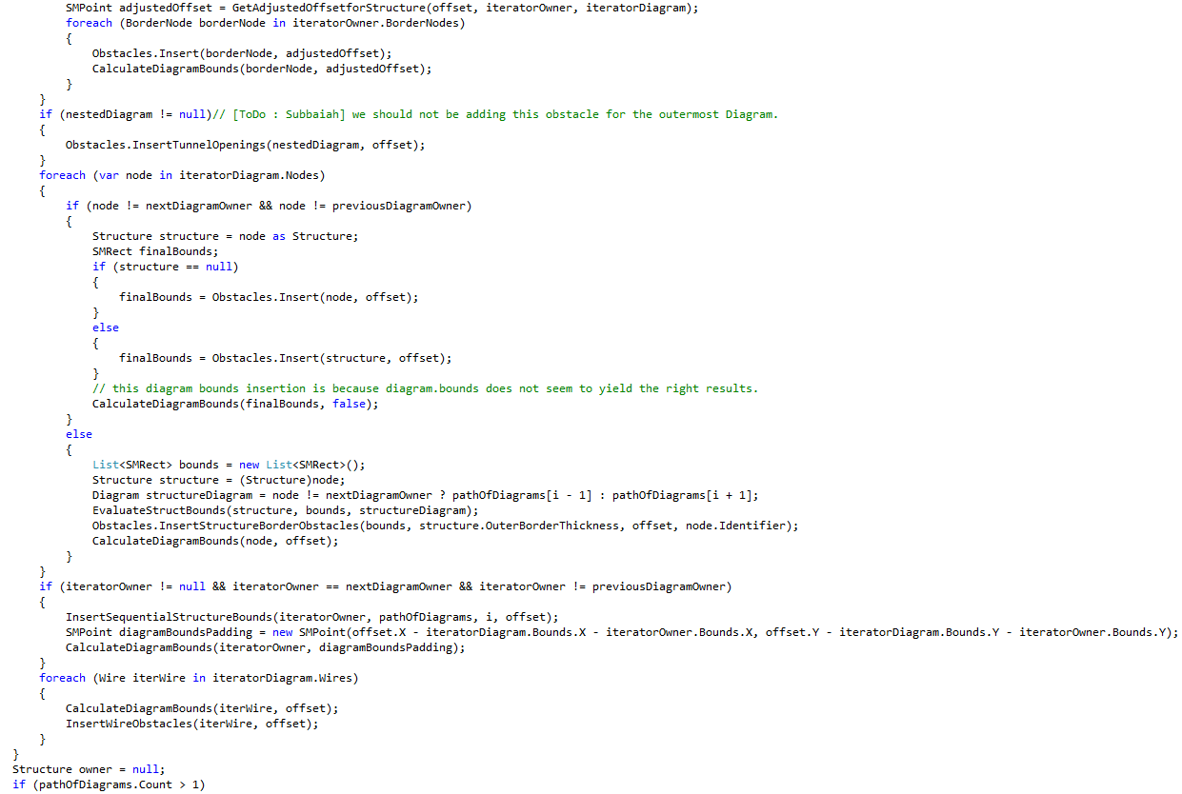

Slide 98
Too Long
Notes:
C:\code\FluencyPowerPoint\PowerPointGeneration\PowerPointGeneration.Tests\CodeSmells-LongMethods\Too Long 29.png

Slide 99
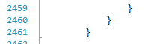

Slide 100
Too Long
Notes:
C:\code\FluencyPowerPoint\PowerPointGeneration\PowerPointGeneration.Tests\CodeSmells-LongMethods\Too Long 30.png

Slide 101


Slide 102
Short Enough
Notes:
C:\code\FluencyPowerPoint\PowerPointGeneration\PowerPointGeneration.Tests\CodeSmells-LongMethods\Short Enough 21.png

Slide 103


Slide 104
Short Enough
Notes:
C:\code\FluencyPowerPoint\PowerPointGeneration\PowerPointGeneration.Tests\CodeSmells-LongMethods\Short Enough 22.png

Slide 105


Slide 106
Short Enough
Notes:
C:\code\FluencyPowerPoint\PowerPointGeneration\PowerPointGeneration.Tests\CodeSmells-LongMethods\Short Enough 23.png

Slide 107


Slide 108
Short Enough
Notes:
C:\code\FluencyPowerPoint\PowerPointGeneration\PowerPointGeneration.Tests\CodeSmells-LongMethods\Short Enough 24.png

Slide 109


Slide 110
Too Long
Notes:
C:\code\FluencyPowerPoint\PowerPointGeneration\PowerPointGeneration.Tests\CodeSmells-LongMethods\Too Long 31.png

Slide 111


Slide 112
Short Enough
Notes:
C:\code\FluencyPowerPoint\PowerPointGeneration\PowerPointGeneration.Tests\CodeSmells-LongMethods\Short Enough 25.png

Slide 113


Slide 114
Short Enough
Notes:
C:\code\FluencyPowerPoint\PowerPointGeneration\PowerPointGeneration.Tests\CodeSmells-LongMethods\Short Enough 26.png

Slide 115


Slide 116
Short Enough
Notes:
C:\code\FluencyPowerPoint\PowerPointGeneration\PowerPointGeneration.Tests\CodeSmells-LongMethods\Short Enough 27.png

Slide 117


Slide 118
Short Enough
Notes:
C:\code\FluencyPowerPoint\PowerPointGeneration\PowerPointGeneration.Tests\CodeSmells-LongMethods\Short Enough 28.png

Slide 119


Slide 120
Short Enough
Notes:
C:\code\FluencyPowerPoint\PowerPointGeneration\PowerPointGeneration.Tests\CodeSmells-LongMethods\Short Enough 29.png

Slide 121


Slide 122
Short Enough
Notes:
C:\code\FluencyPowerPoint\PowerPointGeneration\PowerPointGeneration.Tests\CodeSmells-LongMethods\Short Enough 30.png

Slide 123


Slide 124
Too Long
Notes:
C:\code\FluencyPowerPoint\PowerPointGeneration\PowerPointGeneration.Tests\CodeSmells-LongMethods\Too Long 32.png

Slide 125


Slide 126
Short Enough
Notes:
C:\code\FluencyPowerPoint\PowerPointGeneration\PowerPointGeneration.Tests\CodeSmells-LongMethods\Short Enough 31.png

Slide 127


Slide 128
Too Long
Notes:
C:\code\FluencyPowerPoint\PowerPointGeneration\PowerPointGeneration.Tests\CodeSmells-LongMethods\Too Long 33.png

Slide 129


Slide 130
Too Long
Notes:
C:\code\FluencyPowerPoint\PowerPointGeneration\PowerPointGeneration.Tests\CodeSmells-LongMethods\Too Long 34.png

Slide 131


Slide 132
Short Enough
Notes:
C:\code\FluencyPowerPoint\PowerPointGeneration\PowerPointGeneration.Tests\CodeSmells-LongMethods\Short Enough 32.png

Slide 133


Slide 134
Short Enough
Notes:
C:\code\FluencyPowerPoint\PowerPointGeneration\PowerPointGeneration.Tests\CodeSmells-LongMethods\Short Enough 33.png

Slide 135


Slide 136
Short Enough
Notes:
C:\code\FluencyPowerPoint\PowerPointGeneration\PowerPointGeneration.Tests\CodeSmells-LongMethods\Short Enough 34.png

Slide 137


Slide 138
Too Long
Notes:
C:\code\FluencyPowerPoint\PowerPointGeneration\PowerPointGeneration.Tests\CodeSmells-LongMethods\Too Long 35.png

Slide 139


Slide 140
Too Long
Notes:
C:\code\FluencyPowerPoint\PowerPointGeneration\PowerPointGeneration.Tests\CodeSmells-LongMethods\Too Long 36.png

Slide 141


Slide 142
Too Long
Notes:
C:\code\FluencyPowerPoint\PowerPointGeneration\PowerPointGeneration.Tests\CodeSmells-LongMethods\Too Long 37.png

Slide 143


Slide 144
Too Long
Notes:
C:\code\FluencyPowerPoint\PowerPointGeneration\PowerPointGeneration.Tests\CodeSmells-LongMethods\Too Long 38.png

Slide 145


Slide 146
Too Long
Notes:
C:\code\FluencyPowerPoint\PowerPointGeneration\PowerPointGeneration.Tests\CodeSmells-LongMethods\Too Long 39.png

Slide 147


Slide 148
Too Long
Notes:
C:\code\FluencyPowerPoint\PowerPointGeneration\PowerPointGeneration.Tests\CodeSmells-LongMethods\Too Long 40.png

Slide 149


Slide 150
Too Long
Notes:
C:\code\FluencyPowerPoint\PowerPointGeneration\PowerPointGeneration.Tests\CodeSmells-LongMethods\Too Long 41.png

Slide 151


Slide 152
Too Long
Notes:
C:\code\FluencyPowerPoint\PowerPointGeneration\PowerPointGeneration.Tests\CodeSmells-LongMethods\Too Long 42.png

Slide 153


Slide 154
Too Long
Notes:
C:\code\FluencyPowerPoint\PowerPointGeneration\PowerPointGeneration.Tests\CodeSmells-LongMethods\Too Long 43.png

Slide 155


Slide 156
Too Long
Notes:
C:\code\FluencyPowerPoint\PowerPointGeneration\PowerPointGeneration.Tests\CodeSmells-LongMethods\Too Long 44.png

Slide 157


Slide 158
Too Long
Notes:
C:\code\FluencyPowerPoint\PowerPointGeneration\PowerPointGeneration.Tests\CodeSmells-LongMethods\Too Long 45.png

Slide 159


Slide 160
Too Long
Notes:
C:\code\FluencyPowerPoint\PowerPointGeneration\PowerPointGeneration.Tests\CodeSmells-LongMethods\Too Long 46.png

Slide 161


Slide 162
Too Long
Notes:
C:\code\FluencyPowerPoint\PowerPointGeneration\PowerPointGeneration.Tests\CodeSmells-LongMethods\Too Long 47.png

Slide 163


Slide 164
Too Long
Notes:
C:\code\FluencyPowerPoint\PowerPointGeneration\PowerPointGeneration.Tests\CodeSmells-LongMethods\Too Long 48.png

Slide 165


Slide 166
Too Long
Notes:
C:\code\FluencyPowerPoint\PowerPointGeneration\PowerPointGeneration.Tests\CodeSmells-LongMethods\Too Long 49.png

Slide 167


Slide 168
Too Long
Notes:
C:\code\FluencyPowerPoint\PowerPointGeneration\PowerPointGeneration.Tests\CodeSmells-LongMethods\Too Long 50.png

Slide 169


Slide 170
Too Long
Notes:
C:\code\FluencyPowerPoint\PowerPointGeneration\PowerPointGeneration.Tests\CodeSmells-LongMethods\Too Long 51.png

Slide 171


Slide 172
Too Long
Notes:
C:\code\FluencyPowerPoint\PowerPointGeneration\PowerPointGeneration.Tests\CodeSmells-LongMethods\Too Long 52.png

Slide 173


Slide 174
Too Long
Notes:
C:\code\FluencyPowerPoint\PowerPointGeneration\PowerPointGeneration.Tests\CodeSmells-LongMethods\Too Long 53.png

Slide 175


Slide 176
Too Long
Notes:
C:\code\FluencyPowerPoint\PowerPointGeneration\PowerPointGeneration.Tests\CodeSmells-LongMethods\Too Long 54.png

